Slide 1



Digital Business Transformation Strategy
Naina Grover, Harry Horowitz, Mingxin Li, Weiwen Qi, Jing Dai, Haocong Ding (Team 3)

Slide 2

TABLE OF CONTENTS
Introduction
01
Value Proposition & Business Model Change
02
Digital Disruption & Transformation
03
CSFs & KPIs
04
Barriers & Takeaway
05
GameStop’s current value proposition and business model, competition in the market
Changed value proposition and business model to retain competitiveness.
Threat from digital disruption, framework of transformation, avoid being mimicked
Critical Success Factors that make most imapct; KPIs used to monitor success
Barriers to implement the digital transformation; takeaways from the project

Slide 3


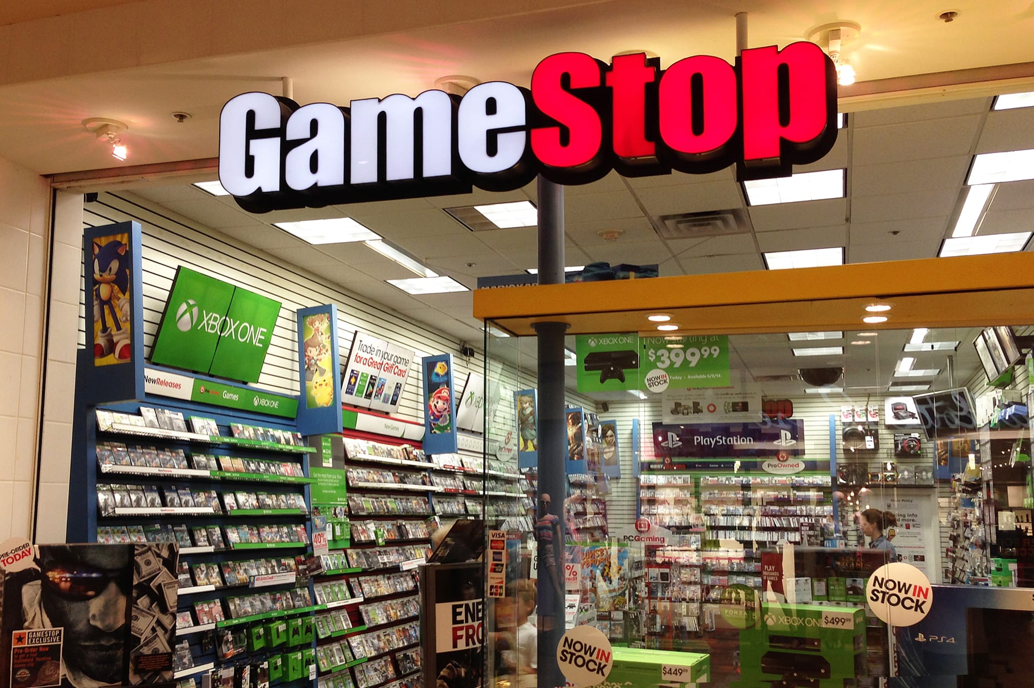
INTRODUCTION
Timeline
1984-1994 Babbage’s
1994-1996 NeoStar Retail Group
1996-1999 Babbage’s Etc.
1999-2004 Barnes & Noble Booksellers
2004-2016 GameStop (Uprise)
2016-2021 GameStop (Decline)
Video game, consumer electronics, and gaming merchandise retailer.
World’s Largest video game retailer
5,509 retail stores

Slide 4

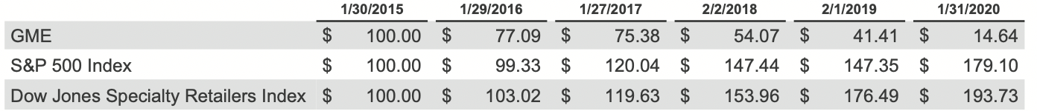
Competition
Highly Competitive + Change in Consumer Preferences
Retail
Walmart
Target
BestBuy
Amazon
Online Enviornment
Sony (Xbox Live)
Microsoft (Play Station Network)
Nintendo (Nintendo eShop)

Slide 5

Current Value Proposition
Convenience
Accessibility
Brand Reputation
Innovation
-Trade-in option
-Location easily accessible
-Offer multiple options
-World's largest omnichannel video game retailer
-Game Informer
GameStop Technology Institute (GTI)
Notes:
AValuePropositionisanencapsulation(statementof)thebenefits thatthebuyer ofaserviceoraproductreceivesfromtheproductorservice.Inother words,itisaconcisedescription ofthereasonsabuyershouldpurchaseaproductora service.Thereareverysimilardefinitionsofthis conceptthatyoucanexploreforadeeper understanding.

Slide 6

Current Business Model
Customer Segmentation
Mass market business model
Channels
Retail store (Brick and Mortar)
Key Activities
Distribution of video game and tech products
Key Partners
Top vendors: Sony (27%), Microsoft (19%), Nintendo (11%), Electronic Arts(10%)
Key Resources
Physical stores
Distribution center
Human resources
Cost-Driven Structure
Single Revenue Stream
Sales of products
Notes:
A business model represents the way in which a company creates, delivers and capturesvalue.Inotherwords,itencompassesthewaysinwhichacompany producesservicesand products, distributes them, prices them and captures revenues.

Slide 7
Nature of Digital Disruption
Source of Digital Disruption
Disruptor: Sony and Microsoft
Physical version vs Digital version
In-game purchase and DLC
Subscription
Emergence of IT, AI, and ML
New digital innovations
Mobile and social media channels

Slide 8
Changed Value Proposition
Affordability
- free for new users
- subscription fee
Accessibility
Brand Reputation
Networking
-available on various operating systems
eg. MacOS, Linux...
-World's largest omnichannel video game retailer
-Game Informer
allow players to communicate
eg. PUBG

Slide 9
Changed Business Model
Customer Segmentation
PC and console players
Channels
Retail store (A digital marketplace)
Value chain
Games-as-a-service (GaaS) model
Offer additional content: new “skins” , season passes
Pricing & Revenue model
A subscription revenue model (Example: Xbox, Playstation)
A freemium model
Notes:
A business model represents the way in which a company creates, delivers and capturesvalue.Inotherwords,itencompassesthewaysinwhichacompany producesservicesand products, distributes them, prices them and captures revenues.

Slide 10
How firm’s changed value proposition help it against competition?
Increasing
revenue
profit margin
Increasing
user engagement
retention rate
number of downloads per user
Increased market share owing to effective pricing strategy than competitors

Slide 11

Whether Gamestop’s Strategy Can Be Mimicked?
Strategy
Culture Hub for Gaming
Brick and Mortar
Online video streaming
On-demand gaming
Mobile gaming
Game analytics and data management
Channel management
Cloud gaming
Improved I.C.E.
GameStop naturally has the customer loyalty of game enthusiasts thanks to decades operation
Bring online platform and offline stores together

Slide 12

Defend GameStop’s Digital Business Transformation Strategy from being mimicked
Time consuming and high cost
Strong Barreiers to enter
Large customers base
Potential of New Entrants
Power of Customers
Power of Suppliers
Competition in the Industry
Multiple suppliers
Long-term partnership
Threat of Substitutes
Comparative advantage:
provide online and offline platforms
powerful data visualization tools
Unique promotion sales and PowerUp Rewards
Offer online game recommendation service based on customers’ preferences

Slide 13

Critical Success Factors
Customer Centered
Launched online stores and easy-to-use smartphone applications for the convivence of our customers
Adopt New Technology
New technology to meet the demand for online shopping and downloading digital versions of games
Innovated Communication
Online working/purchasing method makes the process more efficient, and improves shopping experience

Slide 14
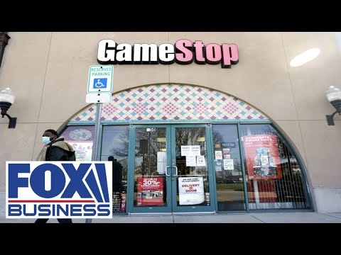
CURRENT FINANCIAL PERFORMANCE
December 30, 2020
Share price: $18.84
January 27, 2021
Share Price: $347.51
March 15, 2021
Share Price: $220.14
Source: https://www.statista.com/statistics/1199882/gamestop-daily-stock-price/

Slide 15

KPI and Steps When Defining KPI
Step 3
Step 4
Step 5
How are you going to measure progress?
How can you influence the outcome?
Step 1
Step 2
Who is responsible for the business outcome?
Step 6
Step 7
What is your desired outcome?
Why does this outcome matter?
How will you know you’ve achieved your outcome?
How often will you review progress towards the outcome?
Notes:
Follow these steps when defining a KPI:

Slide 16

Key Performance Indicators
Millennials
Customer Segment, Increased market share
7.7%
Growth in Revenue by 2022, 13.40% by April, 2021*
Projected Share Price by January 2022*
$399
90%
14 million
Increasing PowerUp Rewards members
Customer Loyalty And Retention Rate
*Source: Yahoo Finance, https://finance.yahoo.com/quote/GME/analysis?p=GME
: Digital Coin Price, https://digitalcoinprice.com/forecast/gamestop-tokenized-stock-ftx/2022
Notes:
Key Process Indicators That The Senior Leadership should track to monitor the extent of success in implementing your strategy.
To achieve this, the strategy calls for the tactic of creating an easy-to-use application for smartphones to keep track of redemption rewards and credits.

Slide 17
Barriers to Success
Digital Transformation Costs
Digital Transformation can be costly. Especially for Gamestop, which has seen a recent decrease in revenues.
Development Sustainability Challenges
Gamestop must continuously improve their new digital systems to stay current with market demands.
Competition
Between established competitors and potential new market entrants, Gamestop must fight to ensure their digital transformations success.
Notes:
Overhauling the entire system and replacing it with digital platform will be very costly for a Gamestop which has seen dwindling performance and profits over the past years.
Large scale digital market site development and maintenance
Mass-marketing costs
Licensing costs for digital games
Gamestop must continually adapt to newer technologies and digital platforms to stay ahead. Digital transformation is not a one time change. It will require continuous development and improvements to stay ahead in the ever changing industry.
Established Competition
Hard to compete with established console producers who provide games directly on consoles via their online platforms. nintendo, ea, sony, microsoft, steam etc.
New Market Entrants
If Gamestop can implement their plan successfully, then they open the door for potential competitors to enter the space and imitate their strategies. amazon, walmart etc.

Slide 18
Takeaways
Digital Disruption
New Value Proposition
Implementation
Digital Transformation
Caused Gamestop to reasses current busines model and digitally transform with online marketplace
Provides customers with accessibility, affordability and networking
Includes: critical success factors, KPIs and awareness of barriers to success
Vital to Gamestop and all companies looking to thrive in 21st century
Notes:
Digital Disruptors have caused Gamestop to urgently reasses their current business model
Digital Transformation in the form of new digital marketplace as a solution
Value Proposition of new strategy provides customers with accessibility, affordability and networking
Digital Transformation strategy must include critical success factors, KPIs and awareness of barriers to successful implementation.
Digital Transformation is vital to the success of Gamestop and any company that wishes to thrive in the ever changing digital economy of the 21st century.

Slide 19
References
Stadler, C. (2021). Can GameStop Win (In The Long-Term)? Lessons For Digital Transformation In Retail. Retrieved 17 March 2021, from https://www.forbes.com/sites/christianstadler/2021/01/30/can-gamestop-win-in-the-long-term-lessons-for-digital-transformation-in-retail/?sh=3380d4062696
Klipfolio. (2021). What is a KPI? Measure your performance against key business objectives. Retrieved from https://www.klipfolio.com/resources/articles/what-is-a-key-performance-indicator
Career at GameStop. (2018, March 03). Retrieved March 18, 2021, from https://www.cleverism.com/company/gamestop/
GameStop 2019 Annual Report. (2019). Retrieved 1 March 2021, from https://news.gamestop.com/static-files/9d2139e1-31c7-498f-ad95-63db1e6d085a
Perrotta, M., 2020. Business Models of Video Games: Past, Present, and Future. [online] Medium. Available at: <https://medium.com/@mjperrotta46/business-models-of-video-games-past-present-and-future-2b2aafe8ade1>
Sivakumar, B., 2020. How Does Steam Work | Steam Business Model | Feedough. [online] Feedough. Available at: <https://www.feedough.com/how-does-steam-work-steam-business-model/#:~:text=Steam%20Business%20Model%20Steam%20operates%20on%20a%20commission-based,Read%3A%20How%20Does%20Slack%20Work%20%26%20Make%20Money%3F>

Slide 20
THANKS
Please feel free to contact:
E:Team3Phase2@jhu.edu
P: +1 620 421 8383
facebook.com/team_3
@Team_3
company/Team_3

